Slide 1
HTML 5 Form elements

Slide 2
Summary of the previous lecture
Creating forms in HTML
Adding form elements

Slide 3
Outline
HTML5 enhancements in form

Slide 4
1. HTML-5 form enhancement
HTML5 enhances the forms in two ways
Adding new attributes to exiting elements
New elements

Slide 5
1.1 The required attribute
Required attribute:
tells the browser to only submit the form if the field in question is filled out
ensures that all necessary information is provided by the user
<input type=“text” name=“name” required>

Slide 6
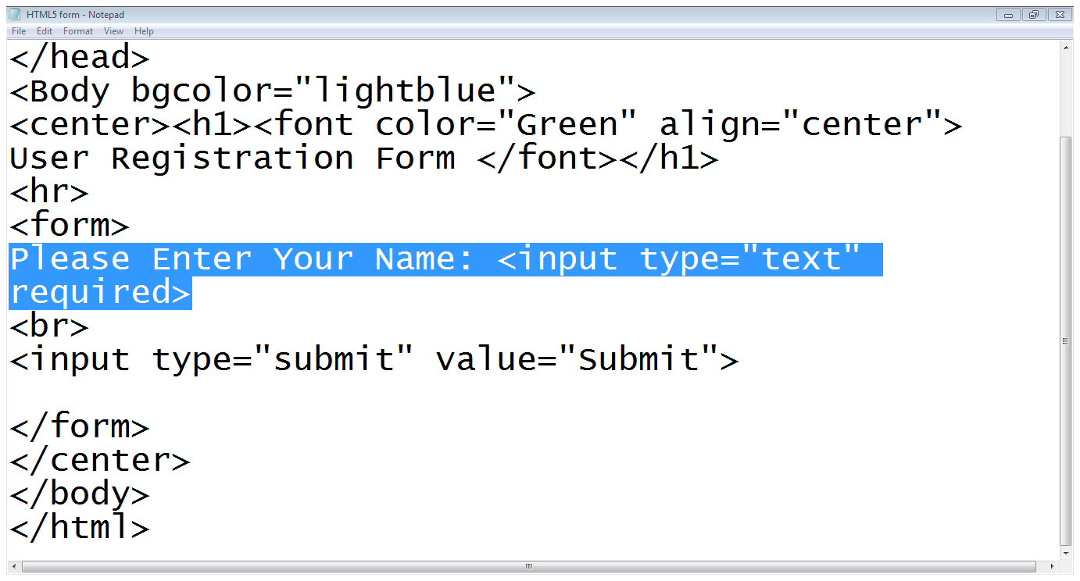
1.1 The required attribute…
Input type
Required attribute

Slide 7
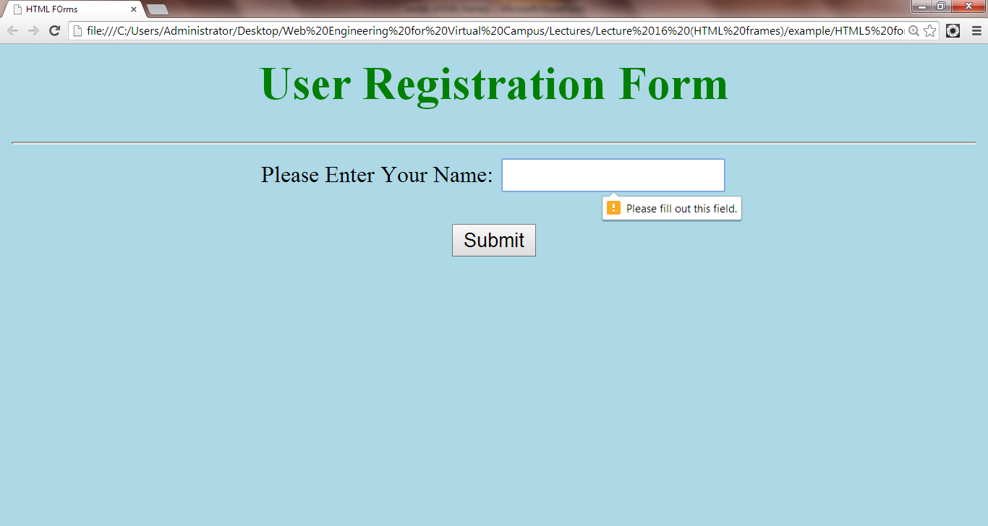
1.1 The required attribute…
Error message

Slide 8
1.2 The placeholder attribute
Placeholder attribute:
Allows a short hint to be displayed inside the form element
tell the user what data should be entered in that field
<input type=“text” name=“name”
placeholder=“Only upper case letters” >

Slide 9
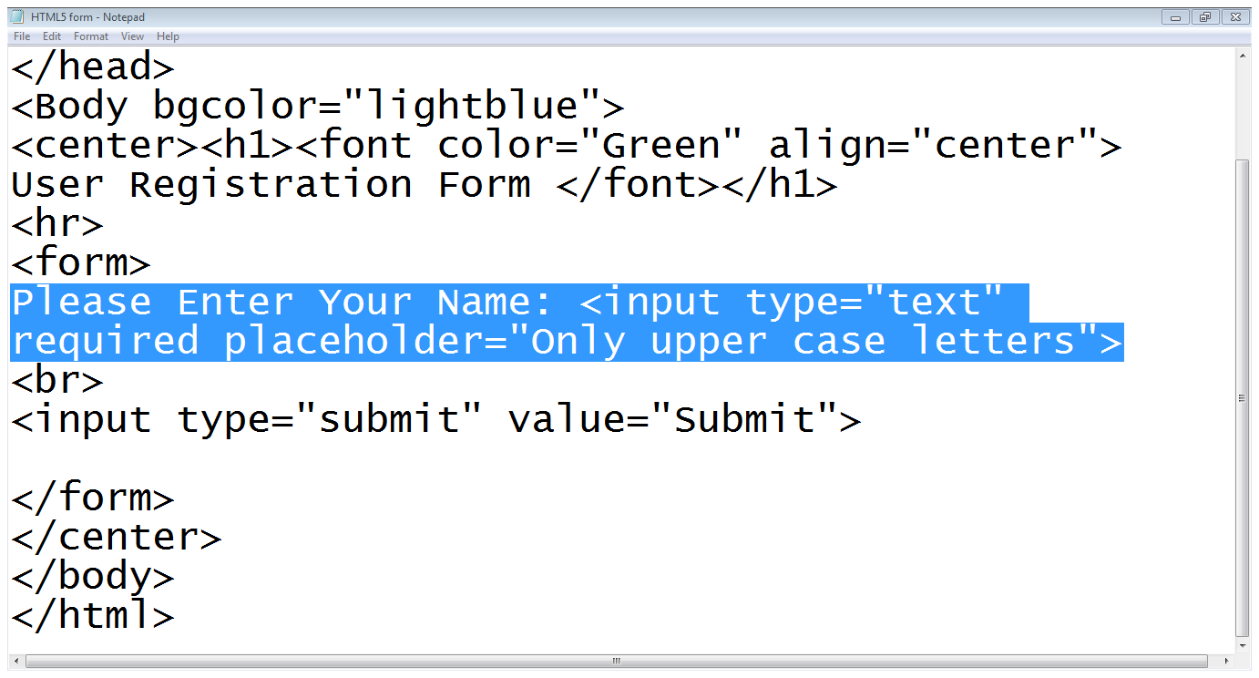
1.2 The placeholder attribute…
placeholder

Slide 10
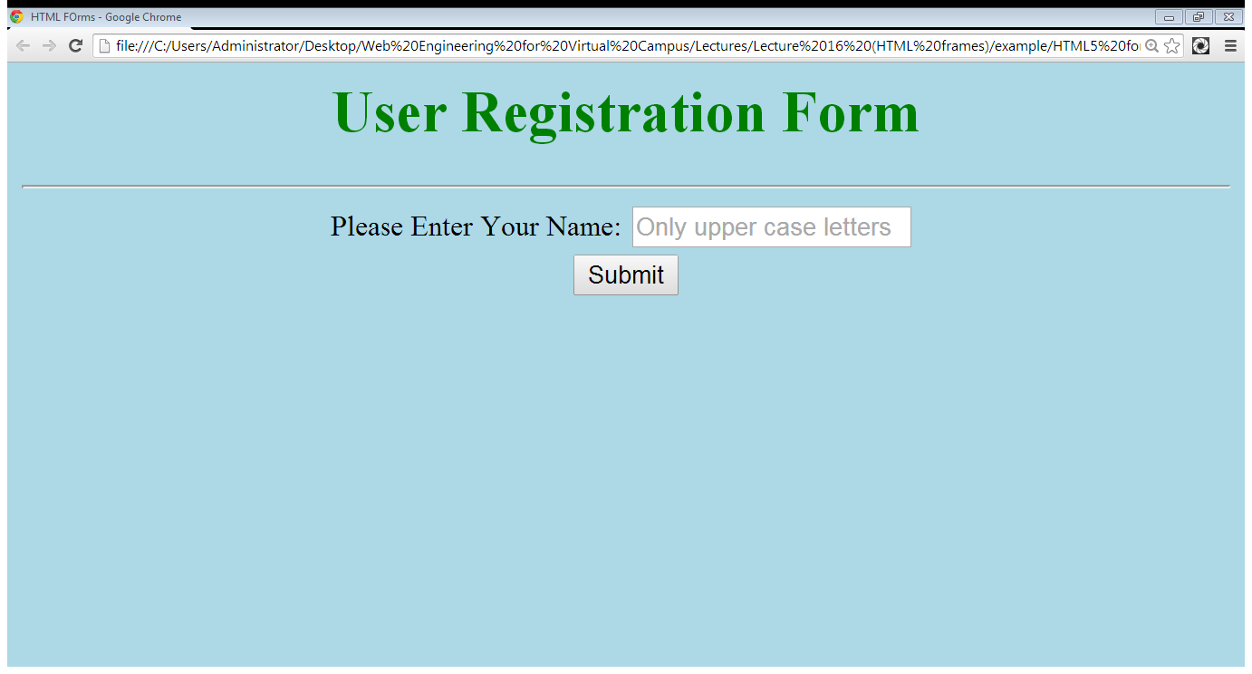
1.2 The placeholder attribute…
Hint about data

Slide 11
1.3 The pattern attribute
pattern attribute:
enables you to provide a regular expression that the user’s input must match in order to be considered valid
<input type=“text” pattern=“Regular Expression”>
<input type=“text” pattern=“[a-z]{1,20}”>

Slide 12
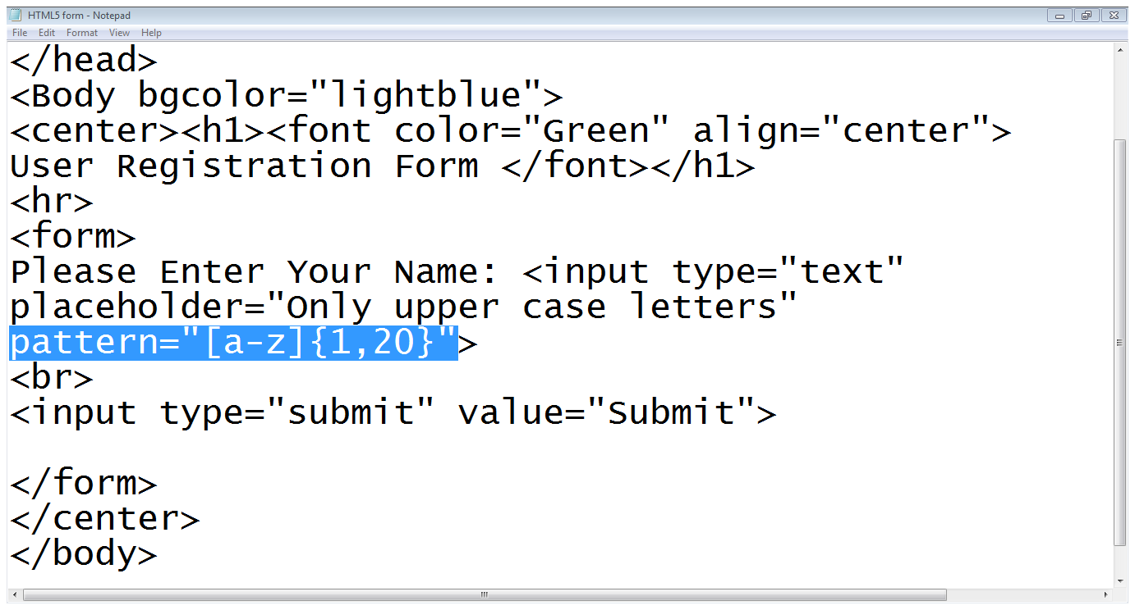
1.3 The pattern attribute
Allowed characters
Valid length
Pattern attribute

Slide 13
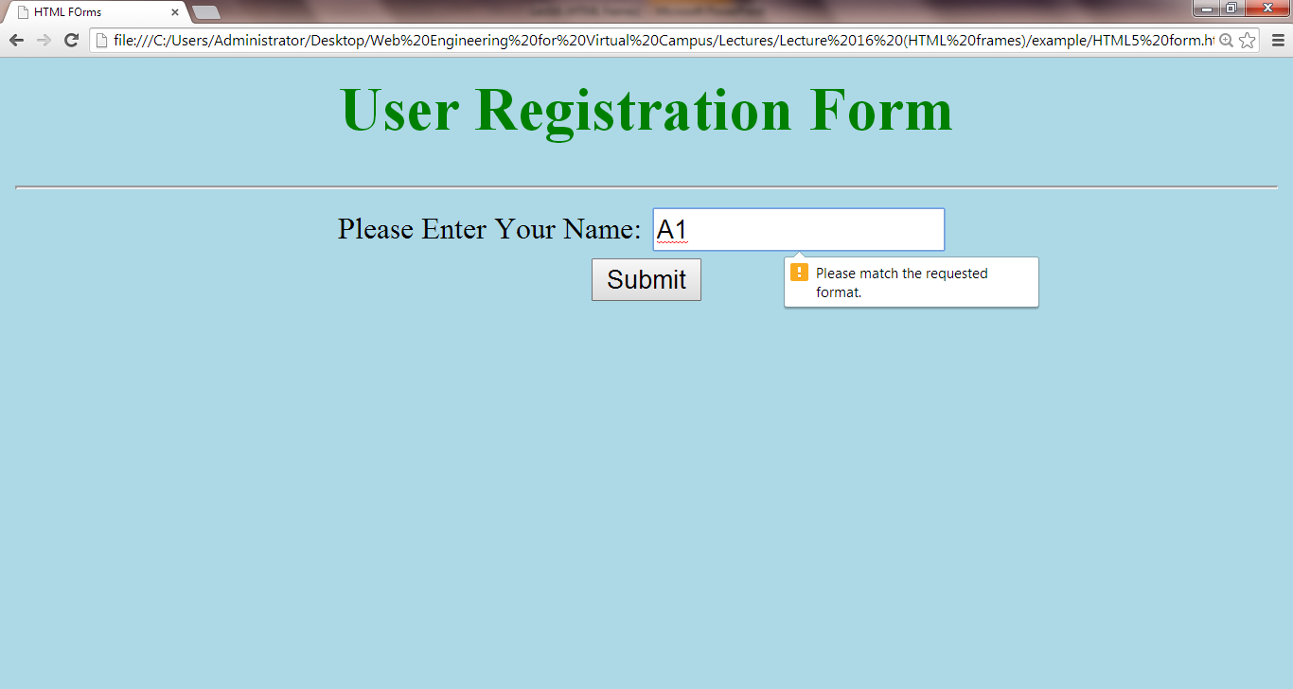
1.3 The pattern attribute…
Invalid input
Error message

Slide 14
1.3 The pattern attribute…
Writing Regular Expression:
[ ]: makes a class of characters
-: means a range of characters
[a-z],[0-9]
[^ ]: negates the class of character
[^0-9]
{n}: matches a character, class or sub-pattern for n times
{ n, m}: matches a character, class or sub-pattern for minimum n times and maximum m times

Slide 15
1.3 The pattern attribute…
Only alphabets
Allowed length
Example patterns:
<input type=“text” pattern=“[a-zA-Z]{1,20} ”>
<input type=“text” pattern=“[a-zA-Z]{1,20} [ ]
[a-zA-Z]{1,20}”>
Allowed length
Space is allowed
Only alphabets
Last name
Allowed length

Slide 16
1.3 The pattern attribute…
Example patterns:
<input type=“text” pattern=“[0-9]{2}[-][0-9]{2}[-][0-9]{4} ”>
<input type=“text” pattern=“[0-9]{5} [-][ 0-9]{7} [-][0-9]{1}”>
Allowed length
Only digits
- symbol
Only digits
Allowed length
- symbol

Slide 17
1.4 The disabled attribute
disabled attribute:
have the content grayed out in the browser
prohibit the user from focusing on a form control that has the disabled
<input type=“text” disabled>

Slide 18
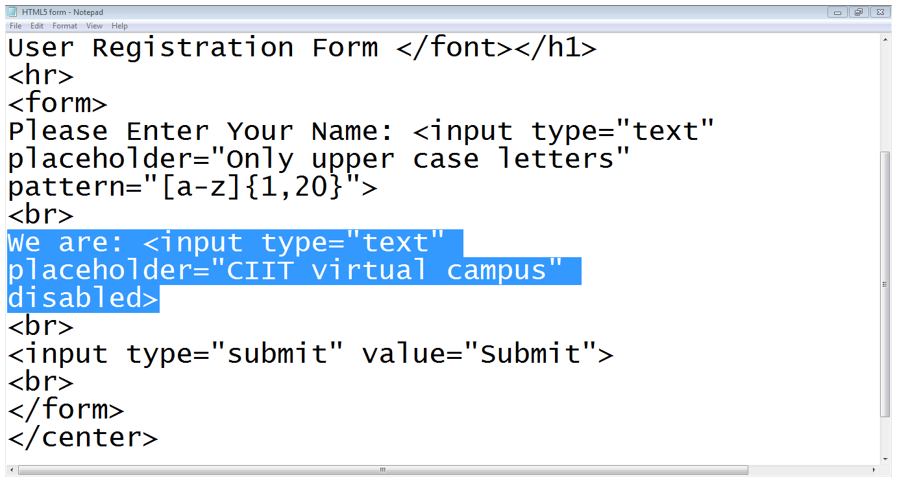
1.4 The disabled attribute…
Input field is disabled

Slide 19
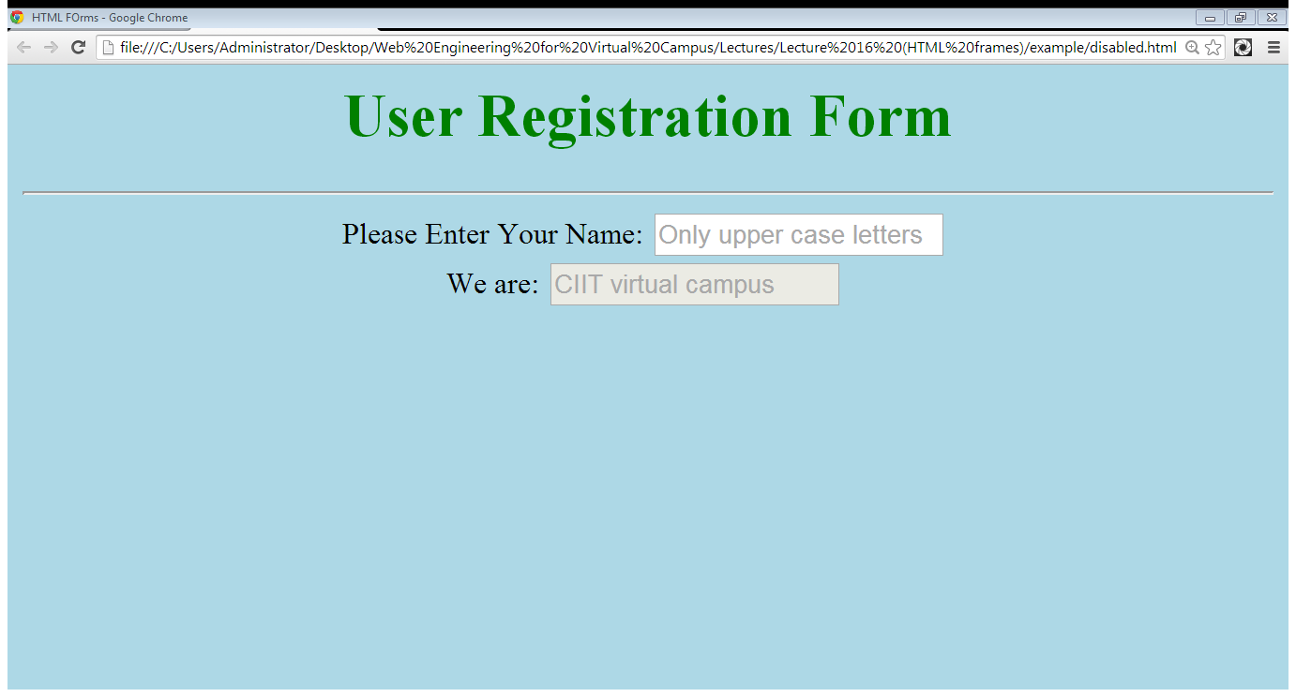
1.4 The disabled attribute…
Disabled field
Input field is disabled

Slide 20
1.5 The readonly attribute
readonly attribute:
it makes it impossible for the user to edit the form field
the field can receive focus
<input type=“text” readonly>

Slide 21
1.6 The autocomplete attribute
The autocomplete attribute:
this will be a drop-down list that appears when the user begins typing
<input type=“text” autocomplete>

Slide 22
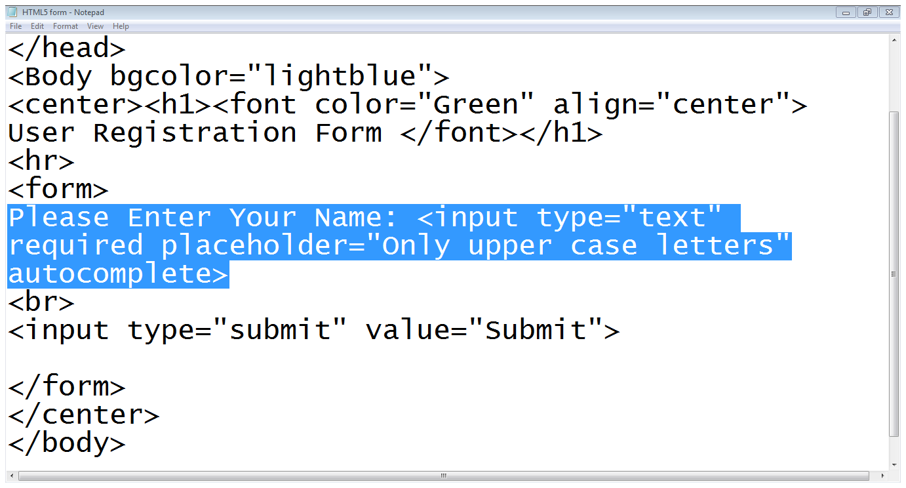
1.6 The autocomplete attribute…
autocomplete

Slide 23
1.7 The datalist element
The datalist element:
a text field with a set of predefined autocomplete options
First we define an input field with list attribute
Then we define the datalist
<input type=“text” list=“colors”>
<datalist id=“colors”>
<option>Red</option>
<option>Red</option>
</datalist>

Slide 24
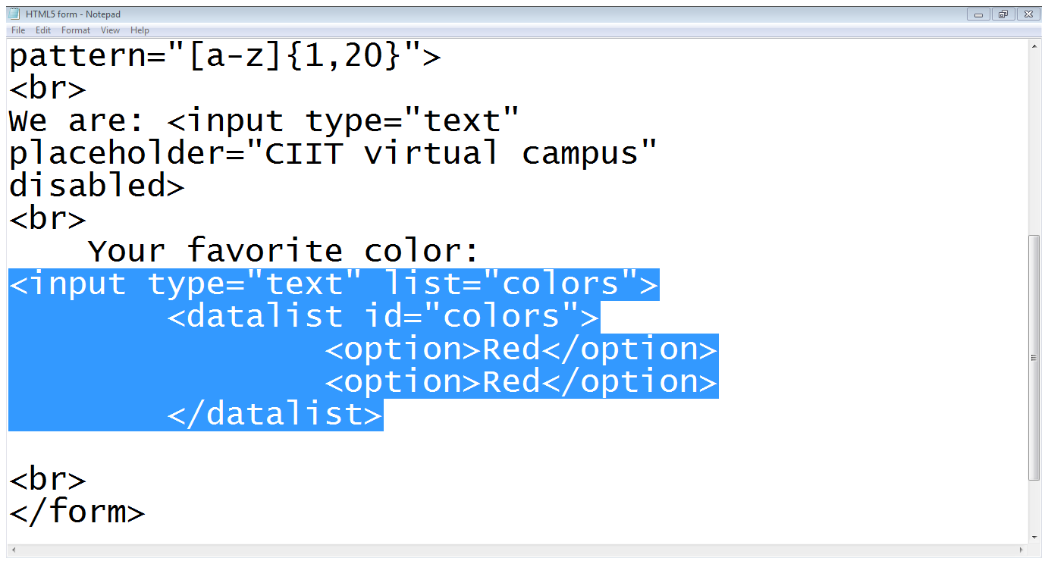
1.7 The datalist element…
List attribute
Datalist starts
Datalist ends
options

Slide 25
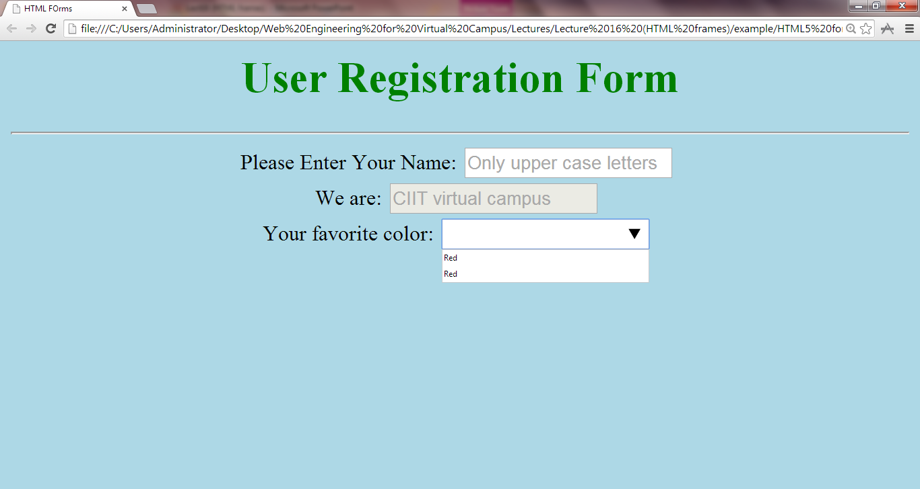
1.7 The datalist element…

Slide 26
2. HTML 5 new elements
Email element
Date element
Number element
Color element

Slide 27
2.1 Email element
The email element:
It ensures that user enters a valid email address
<input type=“email” name=“email”>

Slide 28
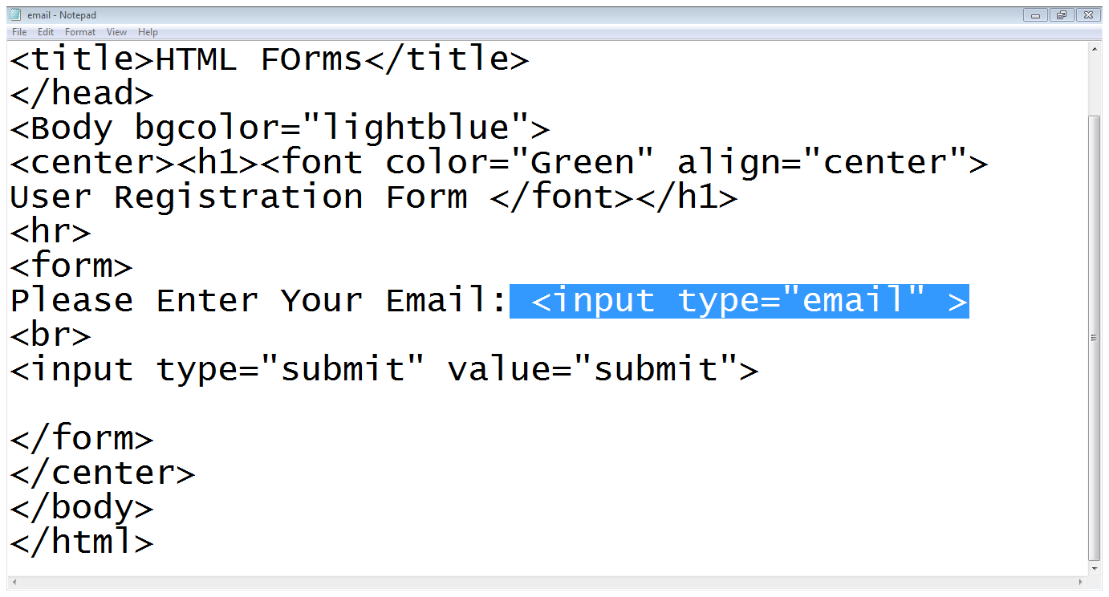
2.1 Email element
Input type

Slide 29
2.2 Date element
The date element:
It shows a calendar to user to select a date
<input type=“date” name=“DoB”>

Slide 30
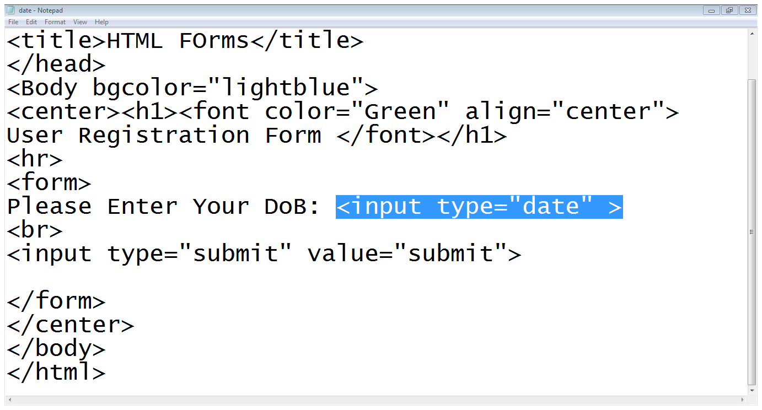
2.2 Date element…

Slide 31
2.3 Color element
The color element:
It facilitate the user to choose a color
<input type=“color” name=“color”>

Slide 32
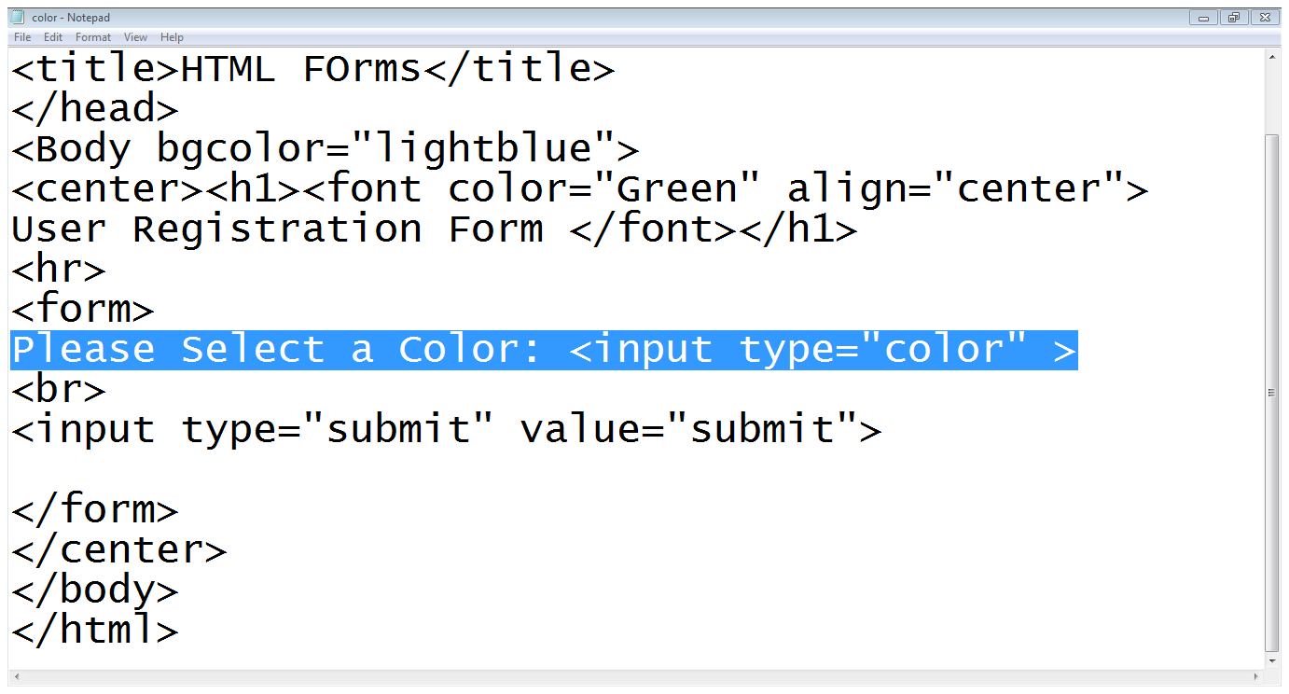
2.3 Color element….

Slide 33
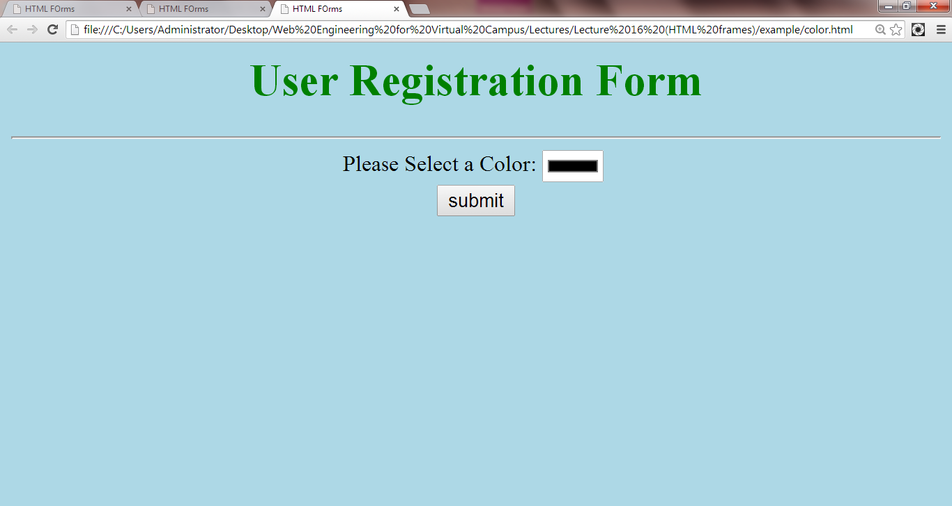
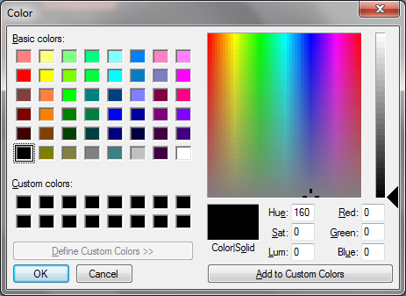
2.3 Color element….

Slide 34
2.4 Number element
The number element:
It ensures that user enters only a numeric value
<input type=“number” name=“number”>

Slide 35
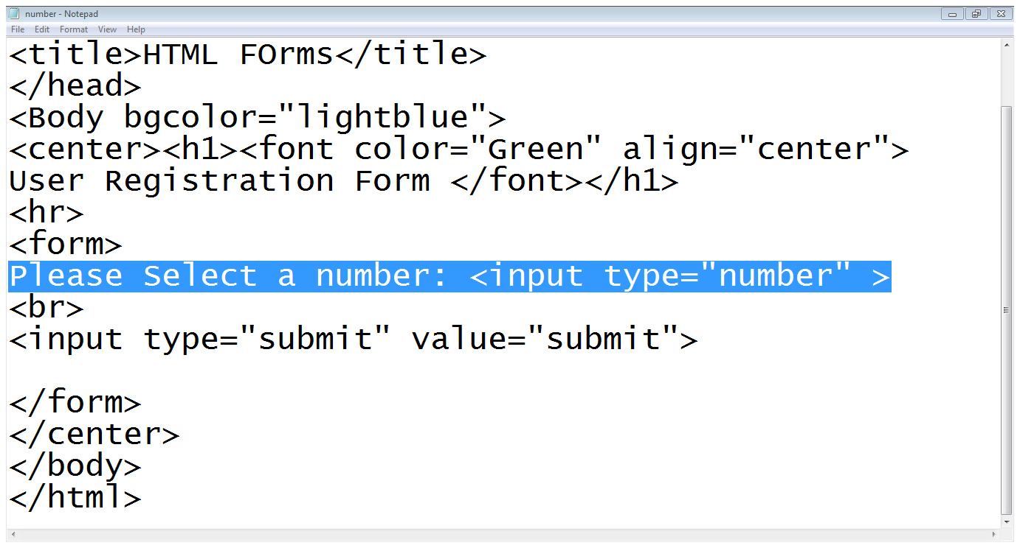
2.4 Number element…

Slide 36
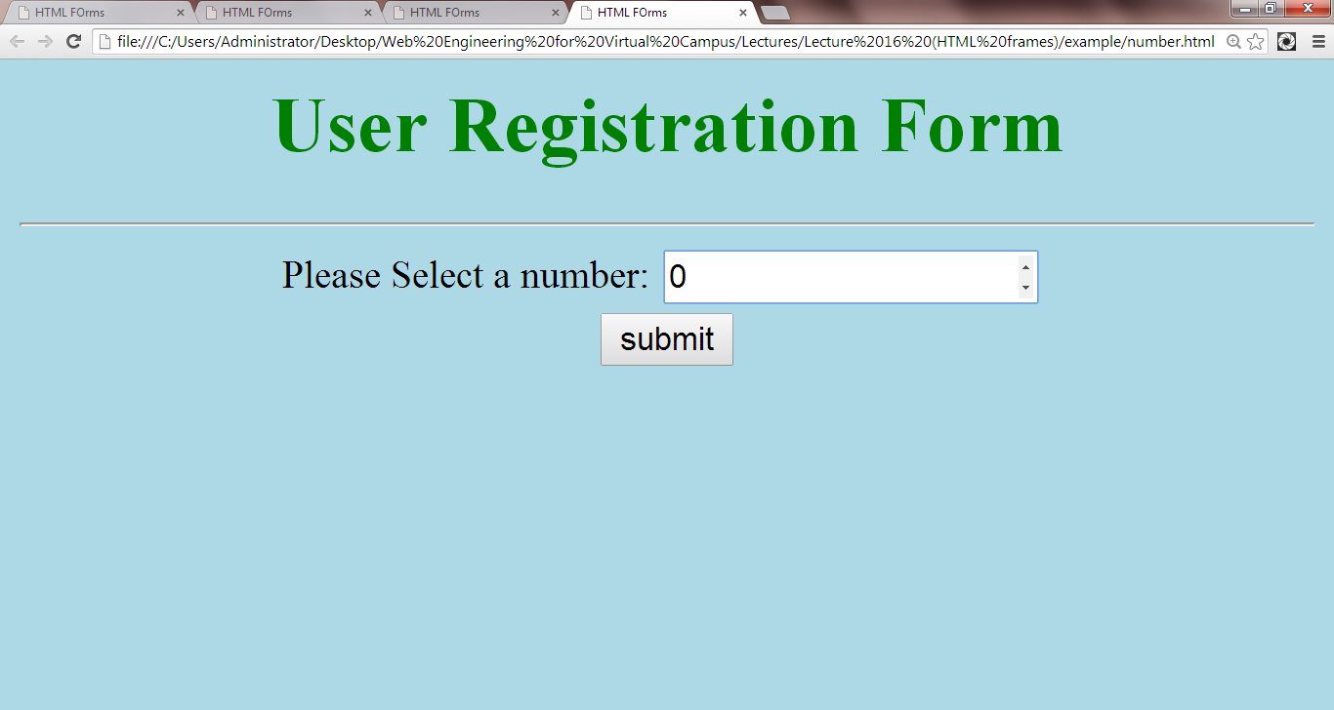
2.4 Number element…

Slide 37
Summary
New attributes to existing form elements
New form elements in HTML5

Slide 38
References
Chapter 4, Beginning HTML, XHTML,CSS, and JavaScript, by Jon Duckett, Wiley Publishing; 2009, ISBN: 978-0-470-54070-1.

